Slide 1
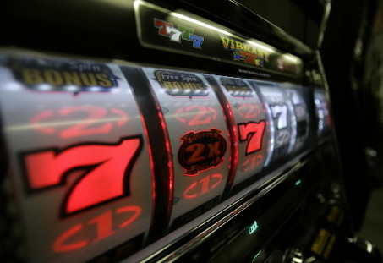
L
U
C
K
Y
S
E
V
E
N
n Insert Coins And Then Press Start Button to Set Up Game For One to Four Players.
n Each Player Shoots One Ball at a Time as Indicated on Back Glass.
n Tilt Penalty - Ball in Play - Tilt Does Not Disqualify Player.
n Top Rollover Lanes and Center Targets Change Playfield Reels.
n Align Symbols on Reels to Increase “Reel Value.”
n Making both Drop Targets scores “Reel Value” & resets targets for possible
repeat scoring. Targets reset only when Some “Reel Value” is lit.
n Reel Value is as Follows:
Clover - Any - Any ____________________________ 5,000 and Double Bonus.
Clover - Clover - Any __________________________ 10,000 and Double Bonus.
Clover - Clover - Clover _______________________ 20,000 and Extra Ball.
Horseshoe - Horseshoe - Horseshoe_______________ 20,000
Diamond - Diamond - Diamond _________________ 30,000
Seven - Seven - Seven ________________________ 30,000 and Special.
n Special Scores ______________________________________ 1 Credit.
n Beating “Highest Score” Scores ______________________ 3 Credits.
n Matching Last Two Numbers
When Game is Over Scores __________________________ 1 Credit.
L
U
C
K
Y
S
E
V
E
N
Williams Electronics
March, 1978
Model Number: 480 / 4,252 produced
Design: Chris Otis
Art: Christian Marche
Williams’ 2nd Solid State Pinball Machine

