Slide 1
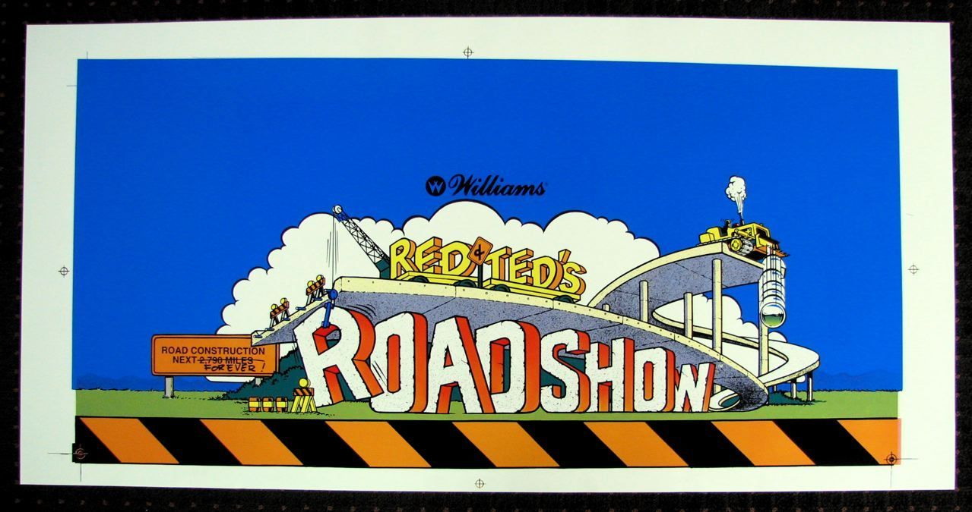
FOR AMUSEMENT ONLY
1 Play → $0.50
2 Plays → $0.75
3 Plays → $1.00
End of Game Extra Ball Buy-In → $0.25
3 Balls Per Game
See Backglass Display for Replay Score

